Slide 1
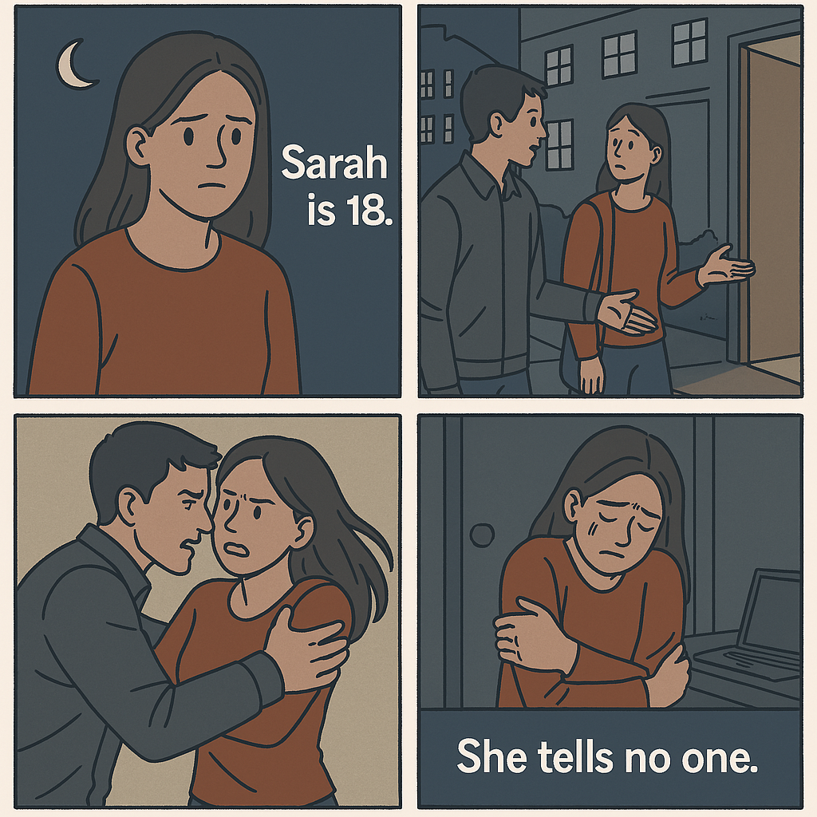
Sarah’s Story – A Common Silence
Sarah, 18, New city, New People
Alone, Offer help.
Unwanted touch
She’s scared, confused and helpless.

Slide 2
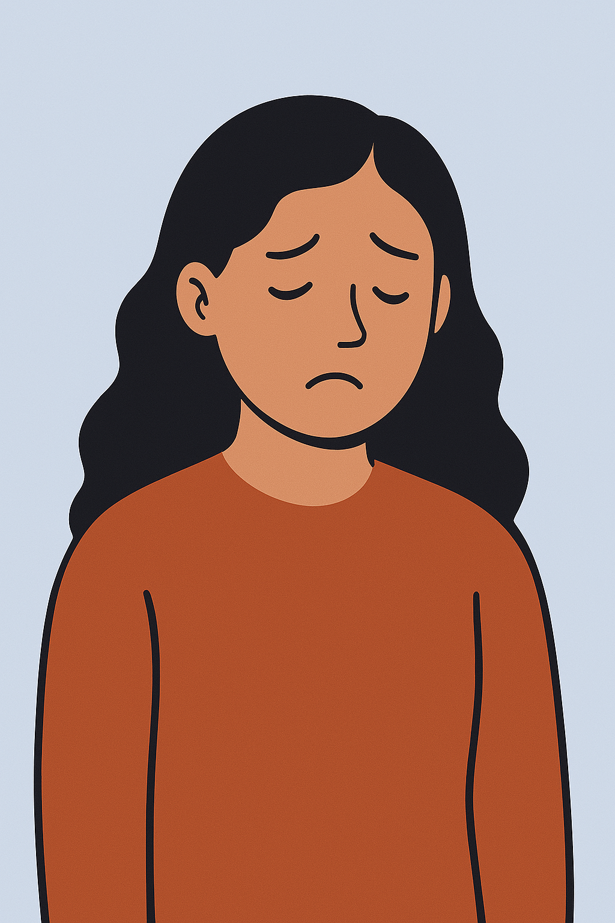
Understanding the Problem
92.3% of students (7,319 total) agreed to answer questions on sexual harassment
Sexualized Comments:
Experienced by 60%+ of students.
32% of female students said they experienced this "Often" or "Many times"
Unwanted attempts to establish a romantic/sexual relationship 56%
Underreporting
Only 5% of students who experienced sexual harassment reported it formally
Common reasons for not reporting:
Shame or embarrassment (51%)
Belief that it wasn’t serious enough
Fear of being blamed
https://hea.ie/assets/uploads/2021/04/Full-report-Students-Jan-2022.pdf

Slide 3
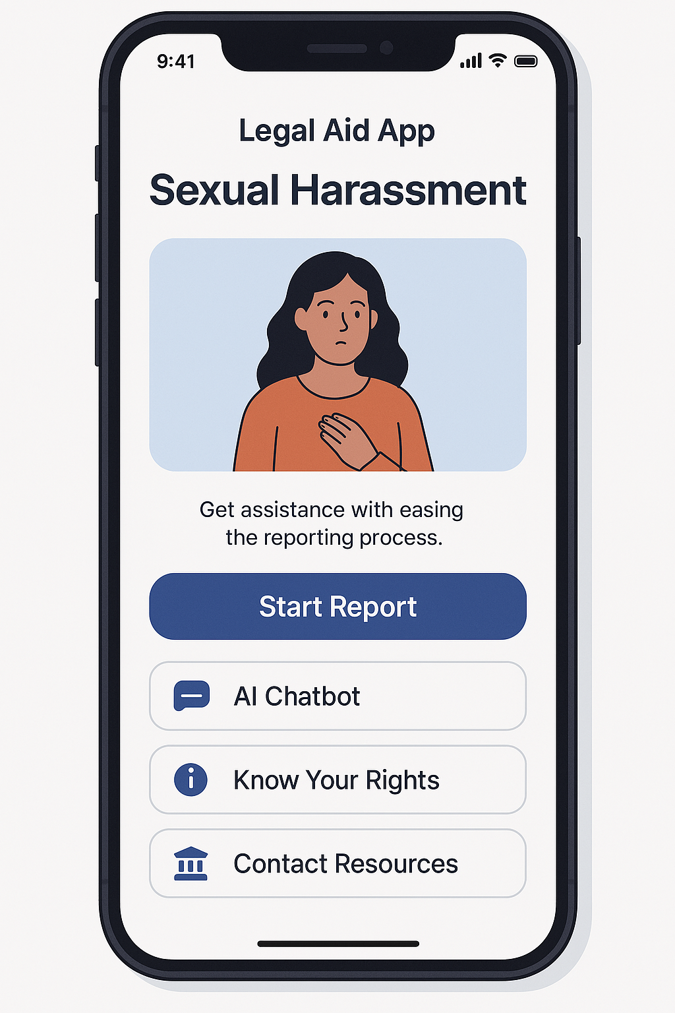
Introducing “True voice” : Your AI Legal Ally
Seamless integration with local applications, including HRMS and university platforms,
offering customized solutions tailored to meet unique organizational needs.
Enter Your Experience.
The app Provides a comprehensive navigation tool of the whole process from reporting the abuse, pursuing legal action, and accessing therapy.
Online Support Groups: Directs you to online supports groups of other survivors
Relevant Laws: Outlines applicable laws and rights,
including state statutes related to sexual abuse.

Slide 4

Scalability and monetization options
Our app will assist lawyers in client procurement by understanding the client's problem and suggesting lawyers who specialize in the relevant field.
It helps organizations manage sexual harassment complaints more effectively.

Slide 5

Your Voice Deserves to Be Heard
Our legal aid app is here to help
you find justice and reclaim your power.

